Slide 1
Becoming a Parish Cllr…
Presentation by Shaun Fishenden PSLCC –
Clerk & RFO to The Ivers Parish Council

Slide 2
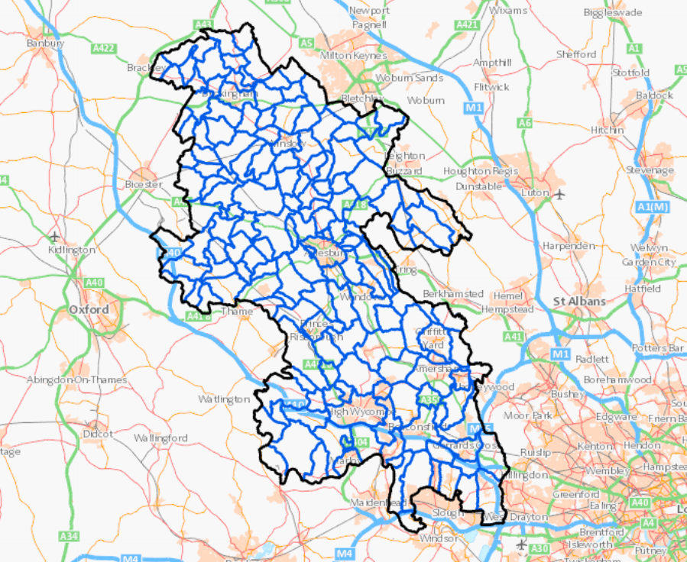
The Parishes in Buckinghamshire
142 Parish and Town Councils
29 Parish Meetings

Slide 3
What is a Parish Council?
Parish Councils are the lowest tier of local government,
they are designed to be closest to the residents they serve and will seek to make
a positive difference to the local communities via operating services directly or
representing residents views to higher-tier authorities and central government
A Parish Council can also be known as a Town Council, Neighbourhood Council, Village Council or Community Council. They all operate exactly the same, its just a name difference
They are largely apolitical, meaning Parish Councillors are not affiliated to a political party

Slide 4
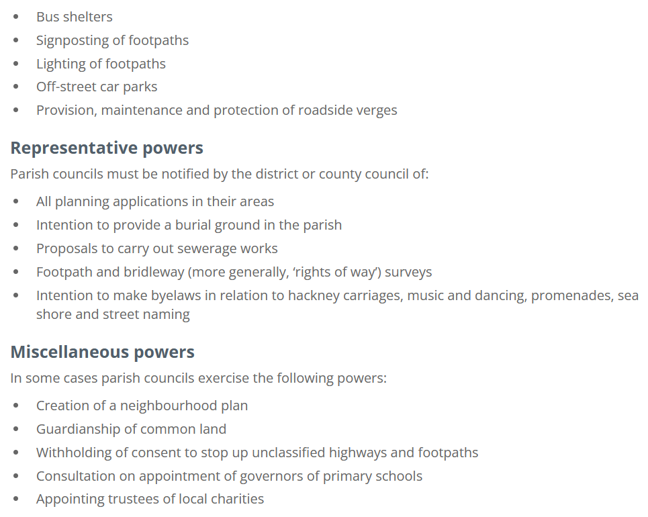
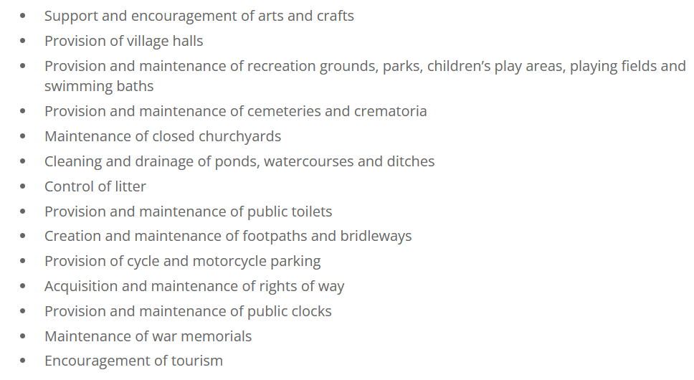
What is a Parish Council responsible for?
In Local Government Legislation; there is only one statutory duty the Parish Council has to provide which is Allotments.
It does however have the powers to provide all of the following if it wishes to:

Slide 5
Responsibilities: The Ivers
Maintenance of twelve Open Spaces (inc. recreation grounds and nature reserves)
Maintaining three play areas (Iver Rec, Iver Heath Rec and Richings Sports Park)
Maintenance of Iver High Street clock
Provision of Christmas Lights and Summer hanging baskets
Provision of St Peters Burial Ground
Provision of Residential Streetlights
Noticeboards
Owner of Jubilee Pavilion, the Parish Hub, Iver Heath Pavilion and 63 Chequers Orchard
Provision of Iver Allotments and Iver Heath Allotments
Maintenance of Iver Village Sign
Acting as a Consultee on Planning Applications
Lobbying Bucks Council and Central Government on local issues

Slide 6
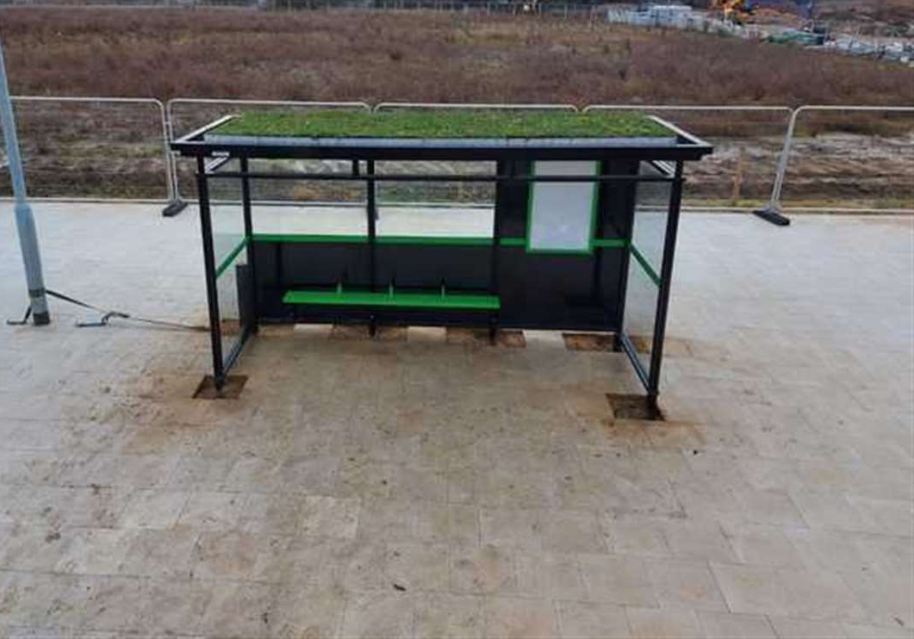
Examples of What Councils can do Higham Parish Council
Introducing bee-friendly Bus Stops

Slide 7
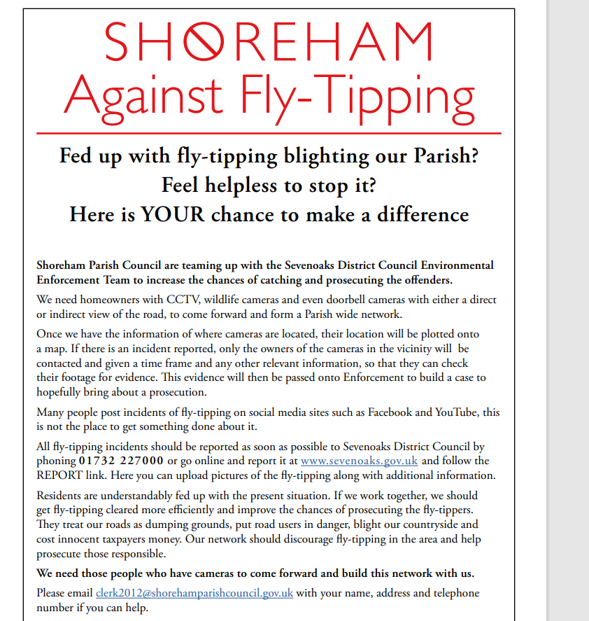
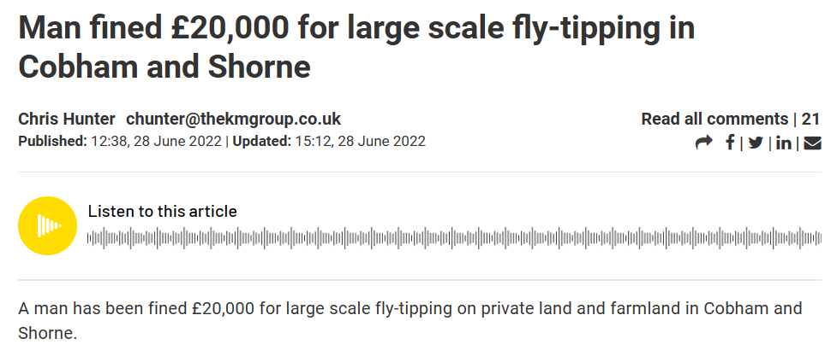
Examples of What Councils can do Shoreham
‘CCTV Networks’
Mobile Camera deployments

Slide 8
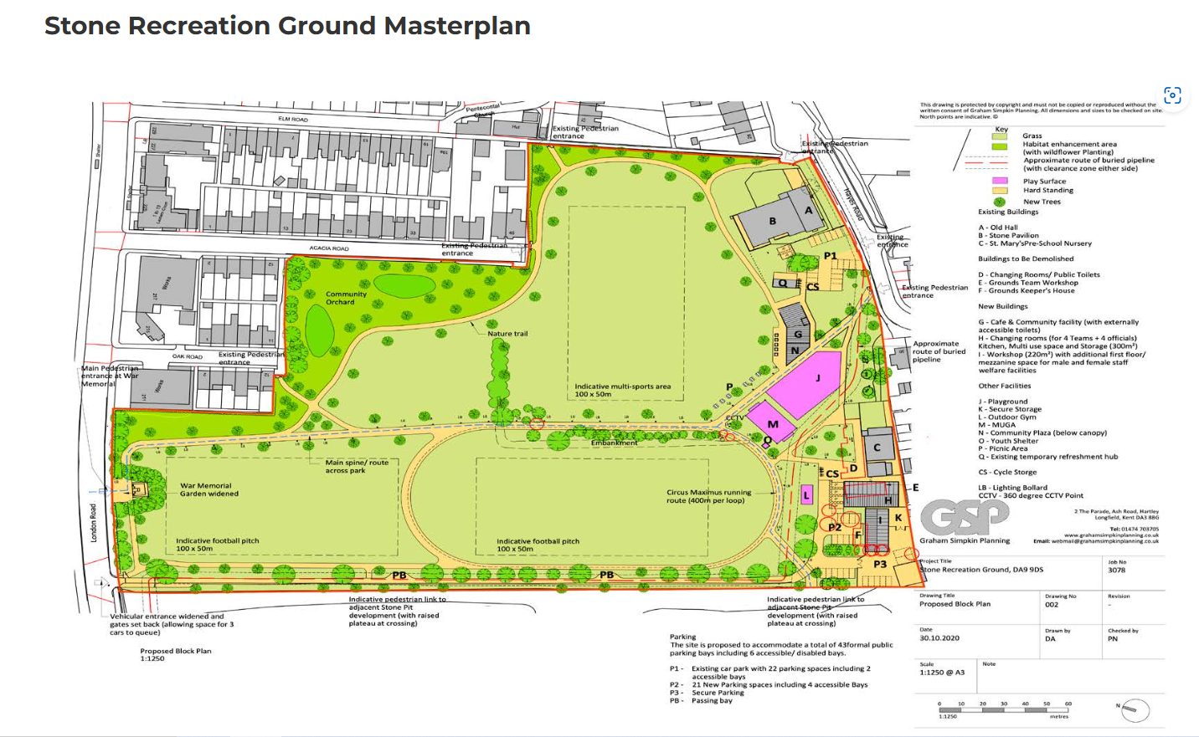
Examples of What Councils can do Stone Parish Council
Significant upgrade to Recreation Ground – new sports pitches and multi-purpose venue

Slide 9
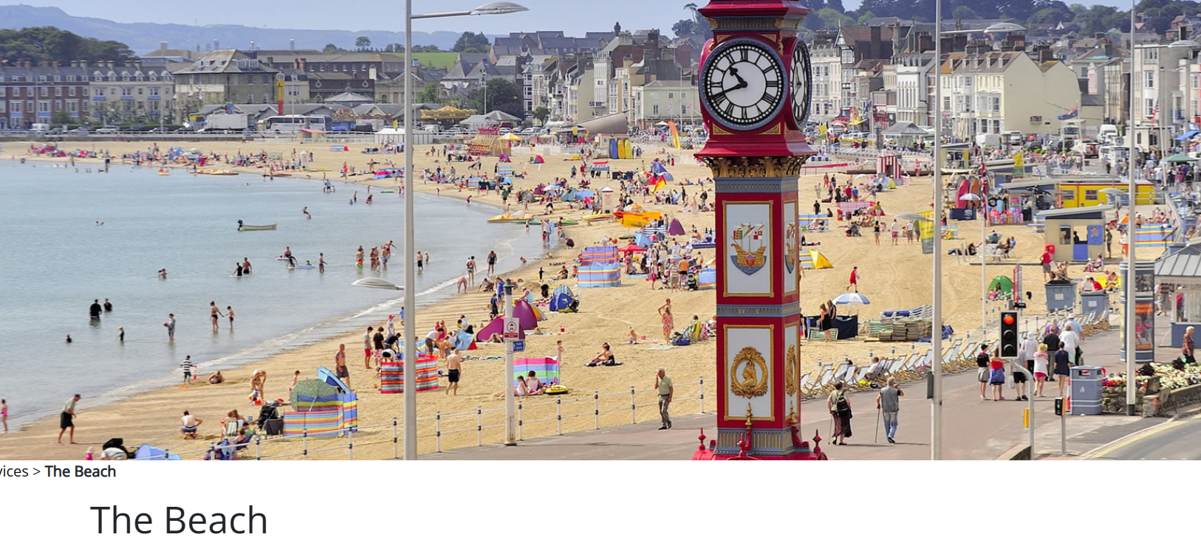
Examples of What Councils can do Weymouth Town Council
Bought Weymouth beach!
Upgraded visitor amusements/ attractions under power to encourage tourism

Slide 10
How are we funded?
Parish Councils largely derive their income from their ‘Precept’, this is the amount levied on council taxpayers within the parish and is collected with Council Tax by the principal authority; in this case Buckinghamshire Council.
The Ivers Parish Council Precept for 2025-26 is £691,326.36 with a per Band D household amount of £142.06
Parishes set their precept at the same time as their annual budget, and the precept will alter every April.
Parishes can also generate income from building rentals e.g. hiring of Pavilions, operating community markets, memorial bench/tree sponsorship schemes
Parish & Town Councils will often use grant funding too. Also have the ability to borrow money from Central Government for projects (Public Works Loan)

Slide 11
The role of the Clerk and Councillors
Parish Councillors are elected/co-opted individuals who are the ‘decision-makers’, they take the strategic decisions, set policy, agree the budget and monitor that decisions are being implemented by officers. They do not involve themselves in day-to-day matters. They will engage with members of the community and feedback issues to Council when necessary.
The Parish Clerk/Proper Officer (and other officers) are responsible for implementing decisions/actions, day-to-day council operations and handling residents enquiries. The Clerk is in effect the ‘CEO’ of the Council and are the Councils sole legal and governance adviser. Clerks will also usually hold the role of ‘Responsible Financial Officer’ meaning they are accountable for ensuring the finances of the council are well-managed

Slide 12
The role of the Parish Council Chairman
Parish Councils elect a Chairman of Council every May, and usually elect a Vice-Chairman too
Chairman have no special powers, their responsibility is to chair the meeting effectively to ensure efficient decision-making
Often the Clerk will work closely with the Chairman, given they need to be fully briefed in order to chair a meeting well.

Slide 13
How Council makes decisions?
Parish Councils operate as a corporate body, meaning no individual councillor can make a decision alone
Councils do have the ability to delegate some decision-making to committees or to officers. Working Groups can be established to make recommendations/conduct research but not make decisions.
Most Parish Councils will hold monthly Full Council and then a series of committee meetings throughout the year.

Slide 14
The Officer Team at The Ivers

Slide 15
Becoming a Parish Councillor: Is a Skillset Required?
Anyone can become a Parish Councillor, there are no barriers to entry
Every role (paid or voluntary) you’ve ever had would have taught you at least one useful skill for being a Councillor
You just have to be committed, willing to learn, happy to engage with people and want to make a positive difference to the local community. Not being afraid of taking tough decisions and thinking strategically is also key.
You do have to be conscious that the decisions you take, can have a huge impact on the local community/individuals.
You get out, what you put in!

Slide 16
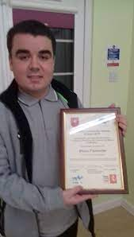
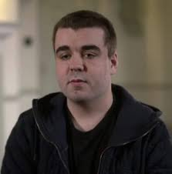
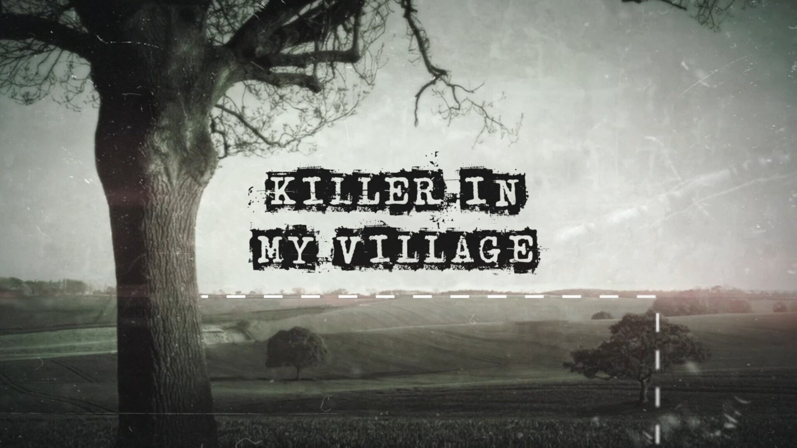
Becoming a Parish Councillor: My Route
Work Experience in ‘privatised’ form of local government
At the age of 16, I organised a series of fifty events and celebrations to commemorate fifty years of New Ash Green. Received an award for this from the Parish Council.
From 2017 to 2020 I studied a Geography degree at Queen Mary University of London
In Oct 2018, I became involved in leading the search for a murder victim; Sarah Wellgreen. Managing over 1000 search volunteers and appearing in documentaries!
A vacancy for the Parish Council became available for co-option in Sept 2020, I applied and was appointed. My fellow Cllrs choosing me over the other candidate because they felt I was enthusiastic, willing to get stuck in and knew the parish well.

Slide 17
Positive Changes
Community Engagement Strategy – in progress
Strengthening links with community groups and residents' associations
Local Council Award Scheme – Silver Award
Green Flag Award

Slide 18
Opportunities post-May 2025 elections
Strategic Plan 2025 – 2029
The Council has commissioned a local government consultant to assist with the development of the council’s first-ever Strategic Plan, to set our priorities for the council term.
This is an opportunity for new Cllrs to influence the priorities we set in our Plan and govern what the Council achieves and what projects we develop over the next four years.
All-Cllr Training
We will also be holding an all-Cllr training session to ensure all Councillors are fully aware of how to effectively utilise their role for the good of the community

Slide 19
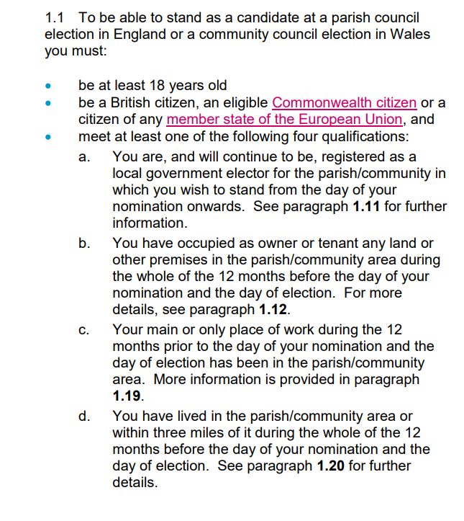
Becoming a Parish Councillor: Eligibility

Slide 20
Elections: Nominations Process
Nomination papers are available from the Buckinghamshire Council website
Your nomination paper must be signed/subscribed by 2 local government electors, that are listed on the 3 March electoral register. The electors must be registered within the ward (or parish, if the parish is not warded) you are standing for election in.
Electoral Services can provide you with the subscribers’ elector number, if you can confirm their name and address. Or you can request for a copy of the electoral register for the area you are standing election in, by completing the forms below and send them to Electoral Services.

Slide 21
Elections: Nominations Deadline

